Slide 1
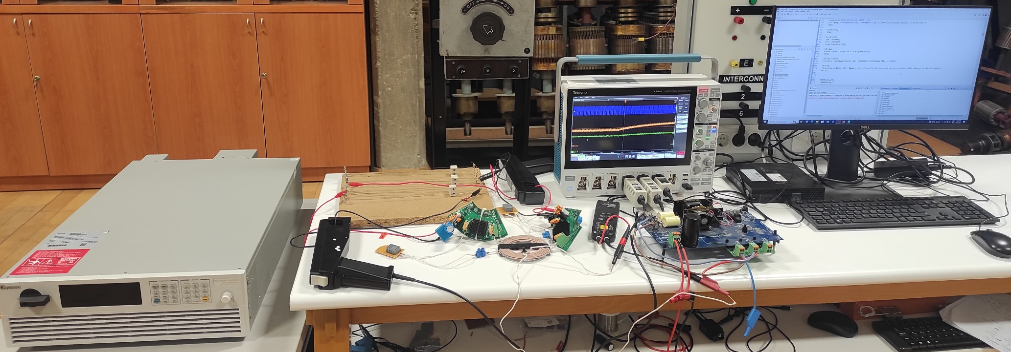
Oscilloscope
Current Probes
Voltage Source
Loads
Voltage Probe
PC
Rectifiers
Resonant Capacitors
WPT coils
Full-bridge Inverter

Slide 2
Oscilloscope
Current Probes
Voltage Source
Loads
Voltage Probe
PC
Rectifiers
Resonant Capacitors
WPT coils
Full-bridge Inverter

Slide 3
FFT

Slide 4
FFT

Slide 5

One fundamental period
FFT

Slide 6
One fundamental period
FFT

